Slide 1
Multi-Objective Evolutionary Algorithms
(Modified partly from the slides of Matt D. Johnson)

Slide 2
Which car would you buy? Why?
Car_id | Age at purchase (in years) | Fuel consumption (mpg) | Cost ($k) | Power (5-15 seconds to go from 0 to 60mpg) | Size (no. of people who can sit comfortably) | FWD (10)/ RWD(01)/ AWD(11)
FirstCar | 15 | 12 | 1 | 9 | 5 | 01
Gradstudent | 8 | 22 | 3 | 14 | 2 | 01
Working | 4 | 25 | 8 | 11 | 4 | 10
Settled | 0 | 28 | 20 | 8 | 4 | 10
Family | 0 | 21 | 28 | 12 | 6 | 10
Green | 0 | 50 | 25 | 9 | 4 | 10
WinterOfLife | 0 | 20 | 30 | 7 | 5 | 11

Slide 3
Human Preferences in Decision-Making
It is impossible to say that one car is the best:
One person may prefer the least expensive car (that runs).
Another may look for the one with the least fuel consumption (mpg).
Another may seek the most powerful one, e.g., measured by time required to go from 0 to 60mpg.
Another may prefer a big car.
How can we compare two cars?
Car1: $28k, 20mpg, old
Car2: $25k, 22mpg, new
Car3: $30k, 18mpg, new
Compare: Car1 >> Car2? Car2 >> Car3? Car3 >> Car1?
Problem: Given 100 cars, which of them are “not clearly worse” than others?

Slide 4
Multi-Objective or Multi-criteria Optimization
Each candidate solution is evaluated along multiple criteria.
Along any criterion, it is easy to say which candidate is better; assume numerical or bitstring representation, e.g., RWD/FWD/AWD: 1/2/3 or 01/10/11.
There may not be a unique “optimal” solution better than others along every criterion.
Some criteria may be negatively correlated.
What kind of solutions should a good algorithm generate?

Slide 5
Dominance
A solution x1 is said to weakly dominate a solution x2 if:
  x1 is no worse than x2 in all objectives.
A solution x1 is said to dominate a solution x2 if:
  The solution x1 is no worse than x2 in all objectives; and
  The solution x1 is strictly better than x2 in at least one objective.

Slide 6
Pareto Optimality
Among a set of solutions P, the non-dominated set of solutions P’ are those that are not dominated by any member of the set P.
The non-dominated set of the entire feasible search space S is the (globally) Pareto-optimal set, which may be infinite.

Slide 7
What should we evaluate (and compare)?
There are several choices:
Raw objective function values
Normalized objective function values,
e.g., (x – mean)/stdev or (x-min)/(max-min)
Ranks (1=best, 2=secondbest, …)
Cars fuel consumption Example:
Raw: 12, 20, 21, 22, 25, 28, 50
Normalized (mean=25.4, s.d. = 11.0): -1.3, -0.5, -0.4, -0.3, 0.0, 0.2, 2.2
Normalized (min=12, max-min=38): 0, 0.2, 0.2, 0.3, 0.3, 0.4, 1
Ranks: 7, 6, 5, 4, 3, 2, 1

Slide 8
Practical questions
We don’t know which solutions are Pareto-optimal; so what should a multi-objective optimization (MOO) algorithm return?
How many solutions should be returned by the algorithm?
Diversity (of solutions) in problem space or objective space?
How can we handle feasibility constraints?

Slide 9
Traditional MOO approaches (which often don’t work well)
Optimize the weighted sum of objectives, using different combinations of weights.
Shoot several “rays” from the origin that intersect the Pareto frontier at different points, conducting linear search along each ray.
Greedy: Start with a diverse set of candidate solutions, explore each neighborhood iteratively to find the nearest non-dominated solution.
Optimize one objective at a time, iteratively adding new objectives.

Slide 10
Weighted Average Approach (using raw values, minimizing, for four of the objectives)
Car_id | Age at purchase (in years) | Fuel consumption : negative(mpg) | Cost ($k) | Powe: negativer (5-15 seconds to go from 0 to 60mpg) | Equal weights | Weights: 4, 2, 1, 3 | Weights: 1,3,4,2
FirstCar | 15 | -12 | 1 | -9 | -1 | 1 | -4
Gradstudent | 8 | -22 | 3 | -14 | -6 | -5 | -8
Working | 4 | -25 | 8 | -11 | -6 | -6 | -6
Settled | 0 | -28 | 20 | -8 | -4 | -6 | -2
Family | 0 | -21 | 28 | -12 | -1 | -5 | 3
Green | 0 | -50 | 25 | -9 | -9 | -10 | -7
WinterOfLife | 0 | -20 | 30 | -7 | 1 | -3 | 5

Slide 11
Weighted Average Approach (using min-max-normalized values, minimizing 4 objectives)
Car_id | Age at purchase (in years) | Fuel consumption : negative(mpg) | Cost ($k) | Power: negativer (5-15 seconds to go from 0 to 60mpg) | Equal weights | Weights: 4, 2, 1, 3 | Weights: 1,3,4,2
FirstCar | 1 | 0 | 0 | -0.2 | 0.2 | 0.3 | 0.1
Gradstudent | 0.5 | -0.3 | 0.7 | -1 | 0.1 | 0.3 | 0
Working | 0.4 | -0.3 | 0.2 | -0.3 | 0 | 0.1 | -0.1
Settled | 0 | -0.4 | 0.7 | -0.1 | 0.1 | 0 | 0.1
Family | 0 | -0.2 | 0.9 | -0.3 | 0.1 | -0.1 | 0.2
Green | 0 | -1 | 0.8 | -0.1 | -0.1 | 0 | 0
WinterOfLife | 0 | -0.2 | 1 | 0 | 0.2 | 0.1 | 0.3

Slide 12
Does any car dominate any others?
(Showing rank for each preference, 1 is best)
Car_id | Age at purchase (in years) | Fuel consumption (mpg) | Cost ($k) | Power (5-15 seconds to go from 0 to 60mpg) | Size (no. of people who can sit comfortably) | FWD (01)/ RWD(10)/ AWD(11)
FirstCar | 4 | 7 | 1 | 3 | 2 | 3
Gradstudent | 3 | 4 | 2 | 7 | 4 | 3
Working | 2 | 3 | 3 | 5 | 3 | 2
Settled | 1 | 2 | 4 | 2 | 3 | 2
Family | 1 | 5 | 6 | 6 | 5 | 2
Green | 1 | 1 | 5 | 4 | 3 | 2
WinterOfLife | 1 | 6 | 7 | 1 | 1 | 1
Notes:
Green>>Family

Slide 13
Does any car dominate any others?
(If cost didn’t matter)
Car_id | Age at purchase (in years) | Fuel consumption (mpg) | Power (5-15 seconds to go from 0 to 60mpg) | Size (no. of people who can sit comfortably) | FWD (01)/ RWD(10)/ AWD(11)
FirstCar | 4 | 7 | 3 | 2 | 3
Gradstudent | 3 | 4 | 7 | 4 | 3
Working | 2 | 3 | 5 | 3 | 2
Settled | 1 | 2 | 2 | 3 | 2
Family | 1 | 5 | 6 | 5 | 2
Green | 1 | 1 | 4 | 3 | 2
WinterOfLife | 1 | 6 | 1 | 1 | 1
Notes:
Transitive Closure of Green>>Family, Green>>Working, Working>>Gradstudent, Settled>>Working, WinterOfLife>>FirstCar

Slide 14
Does any car dominate any others?
(If cost didn’t matter)
Car_id | Age at purchase (in years) | Fuel consumption (mpg) | Power (5-15 seconds to go from 0 to 60mpg) | Size (no. of people who can sit comfortably) | FWD (01)/ RWD(10)/ AWD(11)
FirstCar | 4 | 7 | 3 | 2 | 3
Gradstudent | 3 | 4 | 7 | 4 | 3
Working | 2 | 3 | 5 | 3 | 2
Settled | 1 | 2 | 2 | 3 | 2
Family | 1 | 5 | 6 | 5 | 2
Green | 1 | 1 | 4 | 3 | 2
WinterOfLife | 1 | 6 | 1 | 1 | 1
Notes:
Transitive Closure of Green>>Family, Green>>Working, Working>>Gradstudent, Settled>>Working, WinterOfLife>>FirstCar

Slide 15
Does any car dominate any others?
(If cost didn’t matter)
Car_id | Age at purchase (in years) | Fuel consumption (mpg) | Power (5-15 seconds to go from 0 to 60mpg) | Size (no. of people who can sit comfortably) | FWD (01)/ RWD(10)/ AWD(11)
FirstCar | 4 | 7 | 3 | 2 | 3
Gradstudent | 3 | 4 | 7 | 4 | 3
Working | 2 | 3 | 5 | 3 | 2
Settled | 1 | 2 | 2 | 3 | 2
Family | 1 | 5 | 6 | 5 | 2
Green | 1 | 1 | 4 | 3 | 2
WinterOfLife | 1 | 6 | 1 | 1 | 1
Notes:
Transitive Closure of Green>>Family, Green>>Working, Working>>Gradstudent, Settled>>Working, WinterOfLife>>FirstCar

Slide 16
Does any car dominate any others?
(If cost didn’t matter)
Car_id | Age at purchase (in years) | Fuel consumption (mpg) | Power (5-15 seconds to go from 0 to 60mpg) | Size (no. of people who can sit comfortably) | FWD (01)/ RWD(10)/ AWD(11)
FirstCar | 4 | 7 | 3 | 2 | 3
Gradstudent | 3 | 4 | 7 | 4 | 3
Working | 2 | 3 | 5 | 3 | 2
Settled | 1 | 2 | 2 | 3 | 2
Family | 1 | 5 | 6 | 5 | 2
Green | 1 | 1 | 4 | 3 | 2
WinterOfLife | 1 | 6 | 1 | 1 | 1
Notes:
Transitive Closure of Green>>Family, Green>>Working, Working>>Gradstudent, Settled>>Working, WinterOfLife>>FirstCar

Slide 17
Does any car dominate any others?
(If cost didn’t matter)
Car_id | Age at purchase (in years) | Fuel consumption (mpg) | Power (5-15 seconds to go from 0 to 60mpg) | Size (no. of people who can sit comfortably) | FWD (01)/ RWD(10)/ AWD(11)
FirstCar | 4 | 7 | 3 | 2 | 3
Gradstudent | 3 | 4 | 7 | 4 | 3
Working | 2 | 3 | 5 | 3 | 2
Settled | 1 | 2 | 2 | 3 | 2
Family | 1 | 5 | 6 | 5 | 2
Green | 1 | 1 | 4 | 3 | 2
WinterOfLife | 1 | 6 | 1 | 1 | 1
Notes:
Transitive Closure of Green>>Family, Green>>Working, Working>>Gradstudent, Settled>>Working, WinterOfLife>>FirstCar

Slide 18
Which cars are non-dominated?
(If cost didn’t matter)
Car_id | Age at purchase (in years) | Fuel consumption (mpg) | Power (5-15 seconds to go from 0 to 60mpg) | Size (no. of people who can sit comfortably) | FWD (01)/ RWD(10)/ AWD(11)
FirstCar | 4 | 7 | 3 | 2 | 3
Gradstudent | 3 | 4 | 7 | 4 | 3
Working | 2 | 3 | 5 | 3 | 2
Settled | 1 | 2 | 2 | 3 | 2
Family | 1 | 5 | 6 | 5 | 2
Green | 1 | 1 | 4 | 3 | 2
WinterOfLife | 1 | 6 | 1 | 1 | 1
Notes:
Transitive Closure of Green>>Family, Green>>Working, Working>>Gradstudent, Settled>>Working, WinterOfLife>>FirstCar

Slide 19
Exercise: what are the dominance relationships if you ignore age, cost, and size?
Car_id | Fuel consumption (mpg) | Power (5-15 seconds to go from 0 to 60mpg) | FWD (01)/ RWD(10)/ AWD(11)
FirstCar | 7 | 3 | 3
Gradstudent | 4 | 7 | 3
Working | 3 | 5 | 2
Settled | 2 | 2 | 2
Family | 5 | 6 | 2
Green | 1 | 4 | 2
WinterOfLife | 6 | 1 | 1

Slide 20
Multi Objective Evolutionary Algorithms
(MOEAs)
Using a population of solutions permits simultaneous search in different parts of the multi-objective search space.
Policies are implemented to enforce or encourage “diversity” among the non-dominated solutions found so far.
After any number of generations (iterations) we have a candidate set of solutions for the problem.

Slide 21
MOEA variants
Which evolutionary algorithm?
  PSO (e.g., MOPSO)
  GA (e.g., NSGA-II)
  ES (e.g., PAES)
Archive maintained?
Emphasis on ranks?
How is diversity computed?
Does diversity affect fitness calculations?

Slide 22
MOEA Metrics
Convergence: How close is a generated solution set to the true Pareto-optimal front?
(Sum of distances between generated solutions and nearest Pareto-optimal solution)
Diversity: Are the generated solutions evenly distributed?
(Average distance between each generated solution and its nearest neighbor generated solution)

Slide 23
MOEA Metrics: comparing two algorithms when the Pareto-optimal front is unknown
Convergence: How close is a generated solution set to the collection of non-dominated solutions obtained by both algorithms?
Diversity: What is the ratio of the average distances between solutions obtained by different algorithms?

Slide 24
NSGA-II
Initialization – before primary loop
  Create initial population P₀
  Sort P₀ on the basis of non-domination
  Best level is level 1
  Fitness is set to level number; lower number, higher fitness
  Binary Tournament Selection
  Mutation and Recombination create Q₀

Slide 25
NSGA-II
Primary Loop
  R_{t} = P_{t} + Q_{t}
  Sort R_{t} on the basis of non-domination
  Create P_{t + 1} by adding the best individuals from R_{t}
  Create Q_{t + 1} by performing Binary Tournament Selection, Mutation, and Recombination on P_{t + 1}

Slide 26
Maintaining Diversity in MOEAs
Problem: Populations are finite, but the Pareto set may be infinite or very large.
Possible solutions:
Penalizing the fitness of each individual based on the number of other individuals “near” it, so that not too many offspring are generated from the same group of individuals.
Deleting duplicates (or near-duplicates).
Using a higher mutation rate for individuals in crowded regions.

Slide 27
Other criteria used to compare MOEAs
Hypervolume (in objective space) “under” a polygon formed by the solutions generated by each algorithm.
Number of solutions from each algorithm that are dominated by solutions in the other algorithm.

Slide 28
Using an Archive in an MOEA (e.g., SPEA, PAES, MOPSO, EMOCA)
Maintain an archive (separate subset) of solutions not dominated by any others explored so far.
The archive is not used in offspring generation.
There is a predetermined upper bound on size of archive.
If the addition of a new element to the archive would result in exceeding the upper bound, then a diversity maintenance policy is used to determine which element in the archive is deleted: either data space diversity or objective space diversity may be emphasized.
Elements in the archive may also be deleted if they are dominated by new offspring in the main (reproducing) population.

Slide 29
Strength Pareto EA (SPEA)
The “Strength” of each archived individual is estimated in SPEA as the number of individuals in the population it dominates.
Goal: minimize the “Raw Cost” of an individual = 1+ the sum of the strengths of archived individuals that dominate it.
Archive size maintained by agglomerative clustering followed by deletion of extra individuals from each cluster.

Slide 30
SPEA-II
Strength computations are also performed for individuals in the reproducing population. Raw cost includes the above.
Cost = raw cost + reciprocal of the distance to the j^{th} nearest neighbor
If the archive size is too small, insert lowest-cost individuals from the pop.
Instead of clustering, remove individuals from archive based on distance to nearest neighbors.
Selection and recombination applied to archive!

Slide 31
PAES
Select a parent, then mutate, then add to archive if non-dominated.
If archive is too big, remove the individual nearest to any other element.

Slide 32
MOPSO
Uses an archive.
Particles are mutated before updating population and archive.
Fitness sharing: uses a grid (hypercube), degrading fitness of particles by the number of particles in the same cell. Roulette-wheel selection on the cells, choosing one particle randomly from each cell.
Several newer variations exist.

Slide 33
Epsilon Dominance
Along each objective, require that the quality of one solution is better than:
the quality of the other solution + epsilon, or
the quality of the other solution * (1 + epsilon)
“DEMO” algorithm: uses epsilon-dominance; divides objective space into hyperboxes, and restricts the population from having more than one individual in the same hyperbox.

Slide 34
Epsilon MOEA
Create an initial population P(0)
Epsilon non-dominated solutions from P(0) are put into an archive population E(0)
Choose one individual from E, and one from P
These individuals mate and produce an offspring, c
A special array B is created for c, which consists of abbreviated versions of the objective values from c

Slide 35
Epsilon MOEA
An attempt to insert c into the archive population E
The domination check is conducted using the B array instead of the actual objective values
If c dominates a member of the archive, that member will be replaced with c
The individual c can also be inserted into P in a similar manner using a standard domination check

Slide 36
A Music Design Problem
Chord Progression Objectives:
  Match Chord Pair Percentages
  Maximize number of different chords
  Start with I chord
  End with I or V chord
Arrangement Objectives
  Large Jumps: minimized
  Melody Lengths: should all be the same
  Notes Out of Key: should be minimized
  Cross Voices: should be minimized
  Notes Out of Range: should be minimized
  Bad Chords: (chords not in the chord progression) should be minimized

Slide 37
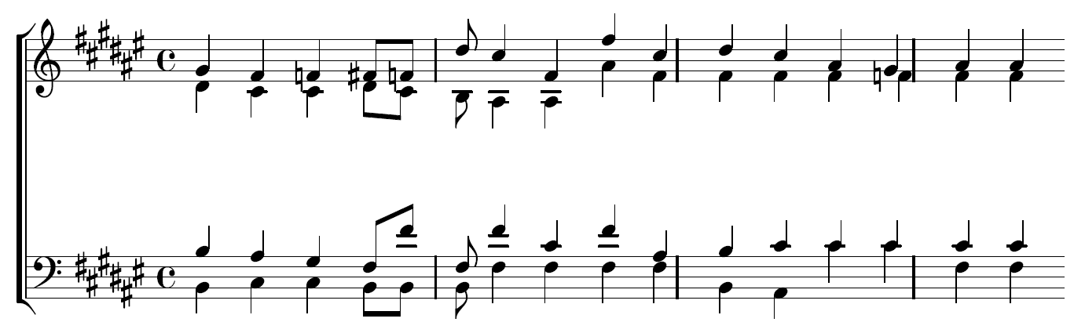
Music: Selection 0

Slide 38
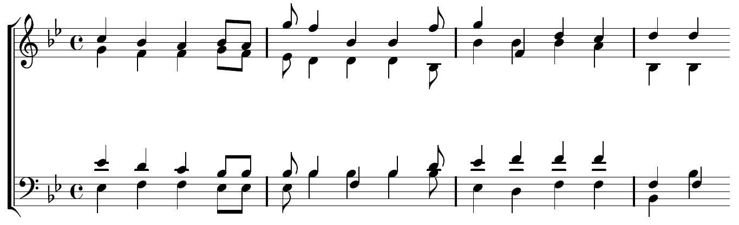
Music: Selection 20

Slide 39
Examples of multi-objective problems
Placement of controllers, distribution centers, …
Engineering system design: power, cost, other properties
Machine learning: FP, FN, other cost measures

